Slide 1




Infosys Solution Approach to BI Modernization
Hersheys Data Platform Setup : DEV Environment
Dec 28, 2021

Slide 2
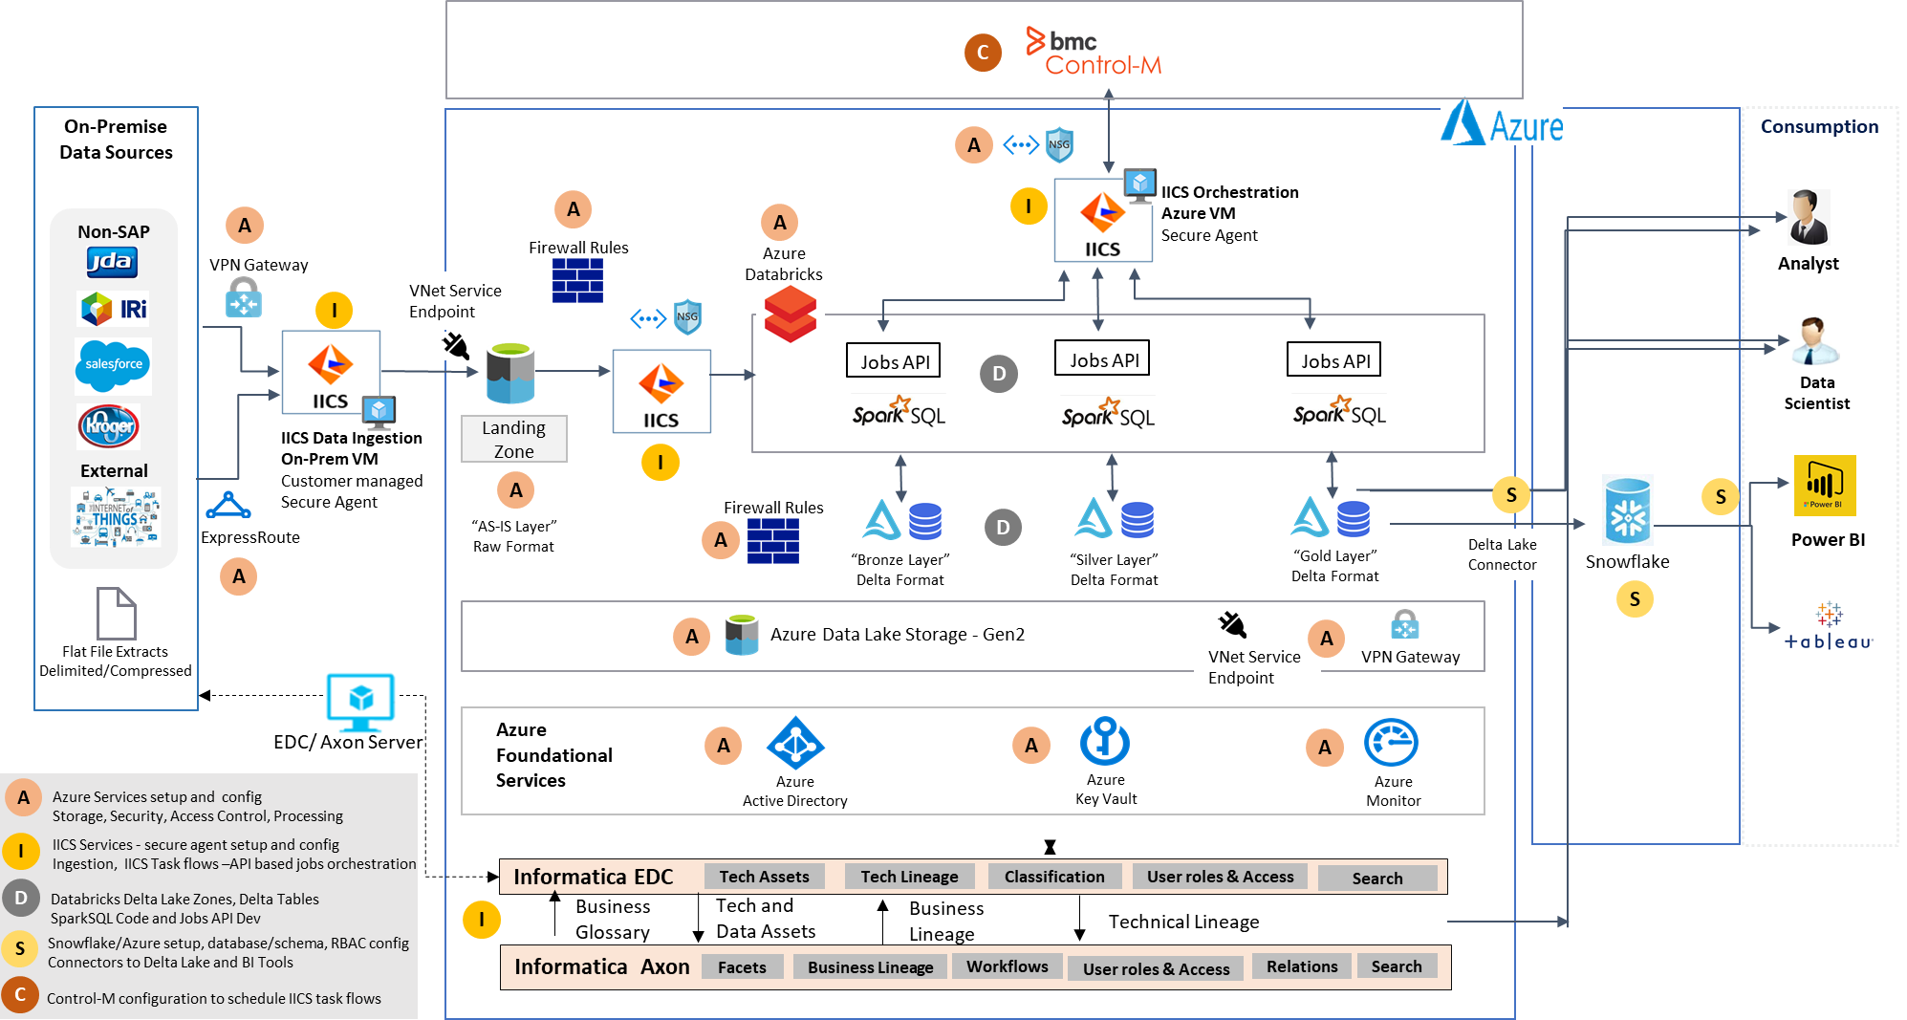
Hershey Data Platform

Slide 3
Hershey Data Platform : DEV Env Setup Activities
Naming Standards defined for Azure Resources
Resources configured in separate resource groups : EDH and EDC with Contributor access
Hershey Admin team assisted with necessary Roles, VNET/SUBNET CIDR, DNS entries, Firewalls, AD Groups Creation
Tags have been added for Azure Resources
Azure Resources Deployed using ARM Templates via CI/CD Pipeline
Resource Locking enabled for Azure Resources
Platform setup documentation created

Slide 4
Hershey Data Platform : DEV Env Setup Activities
Virtual Machines
Provisioned and configured a VM for IICS Secure Agent as per agreed sizing guidelines (Orchestration)
Hershey Provisioned on-premise VM for IICS – Configured Secure Agent (Data Ingestion)
Provisioned and configured an Azure VM for Azure DevOps Agent as per agreed sizing guidelines
EDC : 3 Azure VMs (Linux) , 1 Azure VM (Windows)
SQL Managed instance
One SQL Managed Instance provided for EDC
Storage Account
ADLS Gen2 Storage account created using ARM Template
Created Private endpoints with the given VNet and Subnet
2 Private end points registered to DNS and configured for storage
Created Containers/Folders and defined access controls on the storage account
Key Vault
Provisioned the service
Registered Keys/Secrets for Development environment SPNs as appropriate

Slide 5
Enterprise Data Hub : Platform Setup Activities…
Databricks (Standard Tier)
Workspace creation using ARM template
Successfully deployed Databricks service using parametrized ARM template
Created DBX Workspace
Mount point created to access ADLS Storage account
Created mountpoint to access ADLS Gen2 Storage account
Created sample notebook to read files from ADLS Gen2 Storage account
Created sample table from the flat file
Configured 2 pools as per sizing guidelines (OnDemand & Spot VMs)
Created two clusters from the pools (interactive and job cluster)
Created Standard User Security Groups - – users to be mapped
HDP_EDH_DEV_ADMINS_DBX
HDP_EDH_DEV_DATA_CONSUMERS_CURATED
HDP_EDH_DEV_DATA_ENGINEERS_DBX
IICS
App registration
Org registration
Installed Secure Agent On Prem VM and Azure VM
Able to read file (IRI) from on-premise data source (FTP) to on-premise IICS VM

Slide 6
Enterprise Data Hub : Platform Setup Activities
Snowflake
3 separate accounts created for DEV, TST, PROD
SYSADMIN role access granted to Infosys users via AD group
Basic validation done – able to created warehouse, database, roles, table
Enable Azure Private Link to connect with ADLS Gen2 in East US2 region– able to connect.
Azure DevOps
Repos, branching, folder structure and Build/Release Pipeline setup completed
Azure Services (Azure VMs/SQL DB/Databricks workspace/ADLS Gen2 storage/Log Analytics workspace/Key Vault) deployed using ARM Templates via CICD pipeline
DevOps Agent setup on Azure VM is in progress
Azure Monitoring : Log Analytics Workspace created to monitor the metrics (open issue: private endpoints)

Slide 7
HDP DEV Setup : Open Items
Decision on storage account in East US / East US2 due to dependencies of Azure Private Link for Snowflake
Currently all Azure resources are configured in East US region
Cross region connectivity between ADLS Gen2 (East US) and Snowflake (East US2) is not working
Azure private link works between ADLS Gen2 (East US2) and Snowflake (East US2)
To discuss with Hershey:
Data from Curated Zone of Delta Lake to be replicated to Snowflake
Decision about Curated Zones in different Storage Accounts: East US (Delta Lake) and East US2 (Snowflake)
Cross Region data egress involves cost (10TB ~ 200USD per mth) and likely performance issues (?).
Data Security and ACLs in Delta Lake Curated Zone with Cross region data egress
Is Hershey ok to configure all Azure Services in East US2 region for higher environments?
End-to-end testing through integration of platform layers (planned as Development Use Case):
Data ingestion from on-premise data source to ADLS Gen2 Landing Zone using IICS CDI (Data Integration)
Databricks Job API call from IICS task flow
Replication of Delta Lake Curated Zone table to Snowflake
DevOps Agent setup on Azure VM and Azure CI/CD pipeline enhancements as per discussion with Hershey team
Azure Monitoring : Log Analytics Workspace – Private Endpoints to be created

Slide 8
HDP DEV Setup : Next Steps
Development Use Cases (sample NIA Data Flows identified and approved by Hershey)
Ingestion from On-premise data source to ADLS Gen2 Landing Zone using IICS CDI (Data Integration)
Databricks – Delta Lake : Hive ETL Queries conversion to Spark SQL (DBX Notebooks)
Orchestration of Databricks Jobs (API) using IICS Task Flows
Integration of IICS Task Flows with Control-M
Replication of Delta Lake (Curated Zone) to Snowflake
CI/CD options for IICS, Snowflake and Databricks Code
Setup monitoring for Azure, IICS, Databricks and Snowflake
POC for testing of Data Ingestion using IICS Secure Agent on Azure VM vs On-premise VM
This POC has been suggested by Informatica team during discussion for Foundation Activities
(Effort for this POC was not scoped in foundation phase estimates – will be additional effort)
Determine data access controls and consumption strategy for Delta Lake (Data Scientists) and Snowflake Warehouse (BI Users) and need for Service accounts for different consumption requirements
AD Groups creations for Snowflake and IICS users – Administrators, Developers and Readers/Consumers.
Hershey is looking for Developer Handbook about long term strategy data access control – accounts, user groups, access policies, etc. (Earlier not scoped in foundation activities)
To discuss with Hershey on security configurations like Azure Defender, Enabling Soft Delete for Storage Accounts – these options will incur additional cost

Slide 9
Current Outstanding Issues
IICS Data Integration – encountered firewall issues. Issue was logged for port 443.
Still getting connection error - Team working on troubleshooting

Slide 10
Thank You!

